Slide 1

INDIRA UNIVERSITY SCHOOL OF INFORMATION TECHNOLOGY
MASTER OF COMPUTER SCIENCE
ACADEMIC YEAR 2025-2026
PickMySchool
Secure your future child’s today
By-
11: Apurva More 21: Nishita Rajpara 25: Sejal Walunj

Slide 2
Introduction & Problem Statement
The traditional school admission process is manual, time-consuming, and fragmented. Parents need to visit multiple school websites or institutions separately to collect admission information and fill out different application forms. There is no centralized system to track admission status efficiently.
Key Problems:
Multiple admission forms for different schools
Time-consuming admission process
Lack of centralized admission platform
Difficulties in tracking application status.

Slide 3
“The main objective of our system is to simplify and digitize the complete admission process while improving transparency, efficiency, and communication.”
Centralize school admission process
Save time and effort for parents
Improve transparency in admission decisions
Digitize enquiry and interview tracking
Enhance communication between schools and parents
Provide admin monitoring and management
Objectives of System

Slide 4
Proposed System
A centralized web-based platform that simplifies the school admission workflow.
MODULES
I
Parent Module
School Module
Admin Module
Search schools
Apply online
Track admission status
Review
applications
Send interview confirmation
Update admission
result
Verify schools
Monitor applications
Generate reports

Slide 5
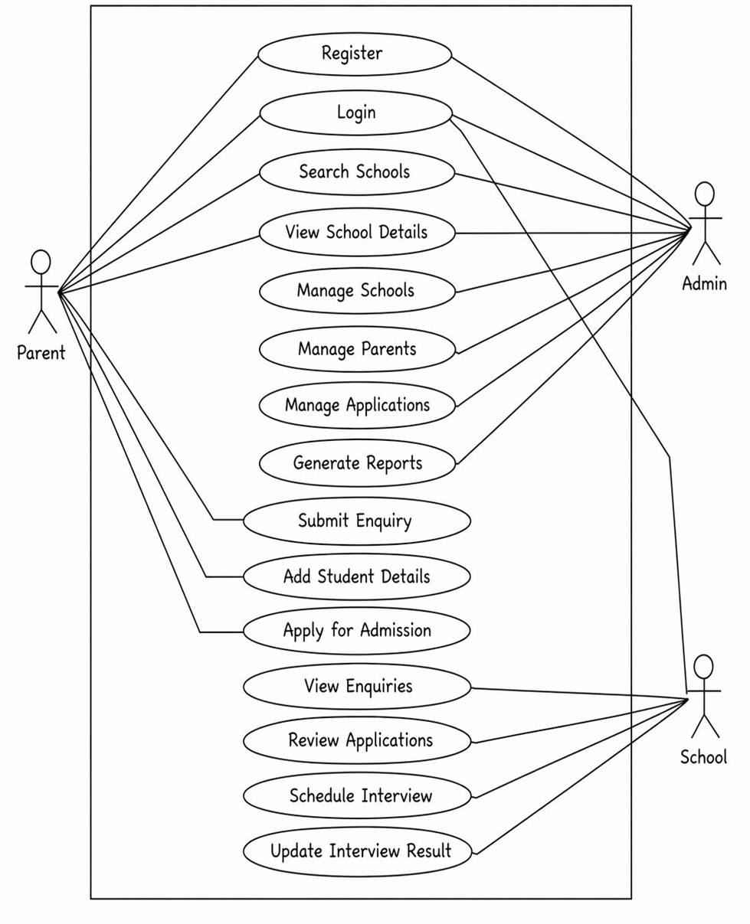
Use Case Diagram

Slide 6
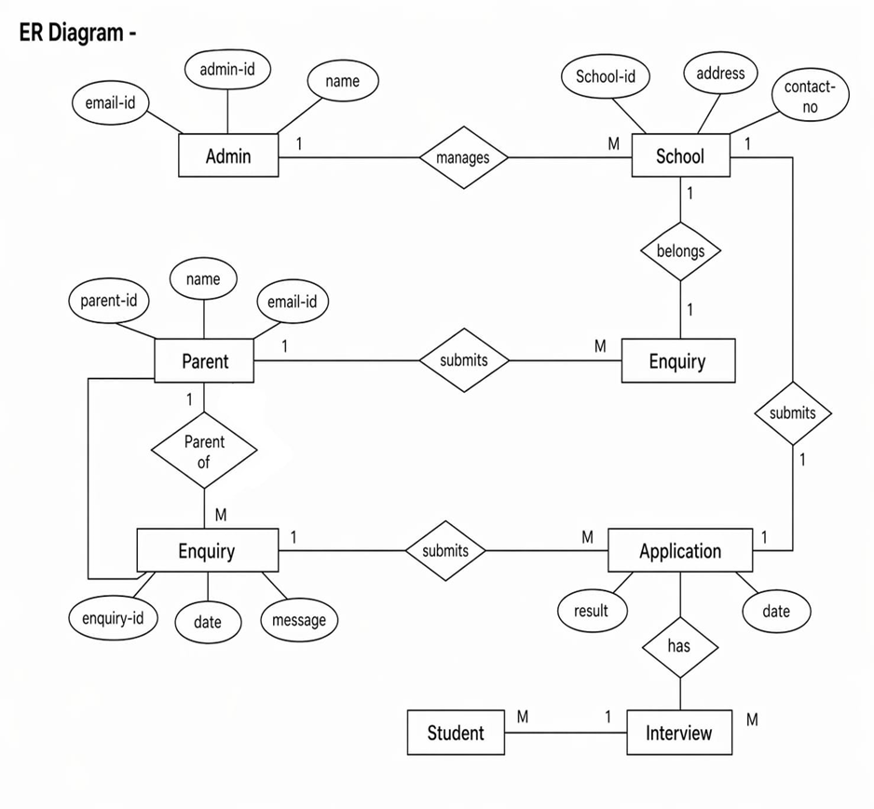
ER DIAGRAM

Slide 7
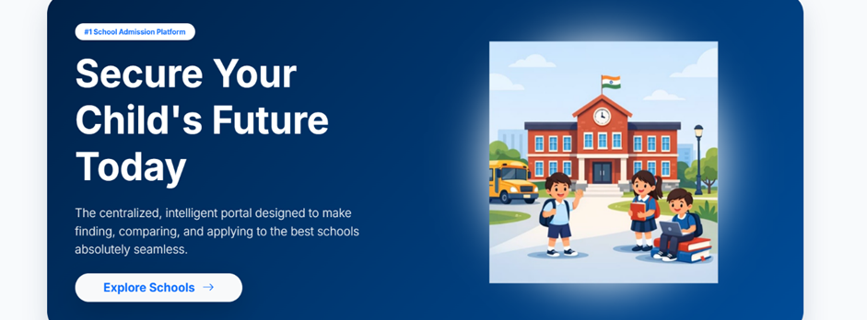
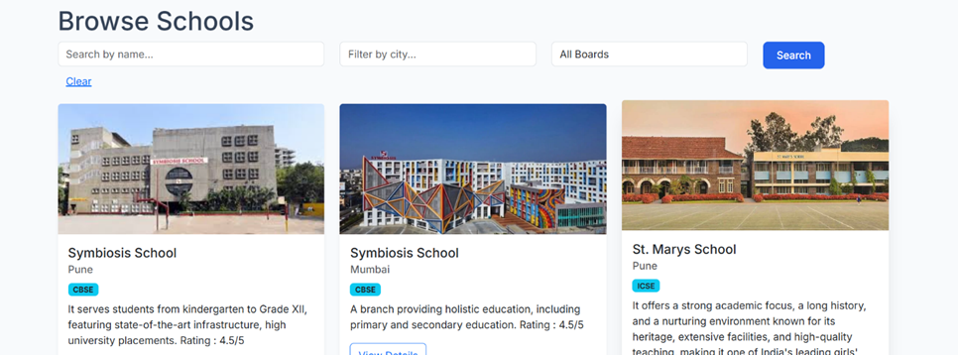
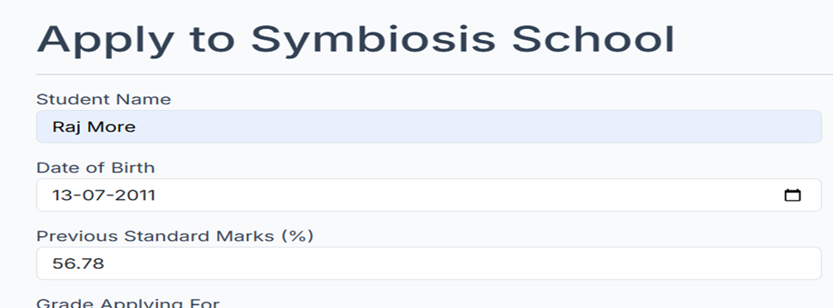
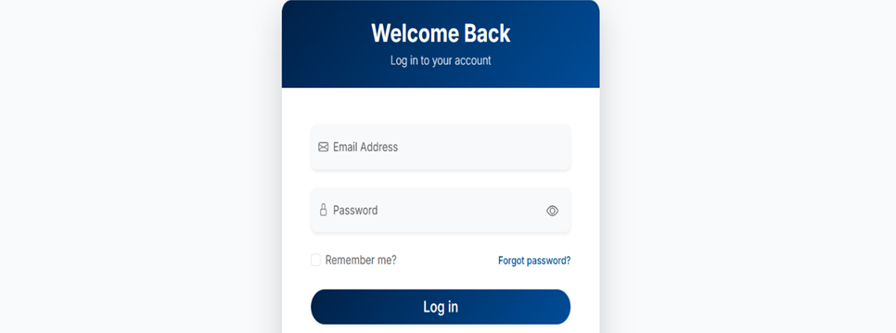
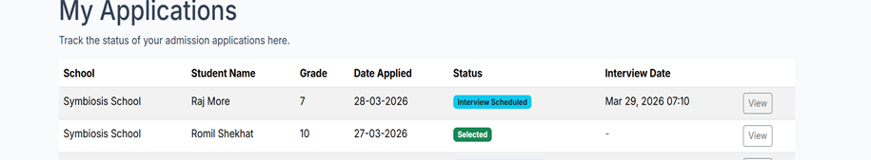

Slide 8
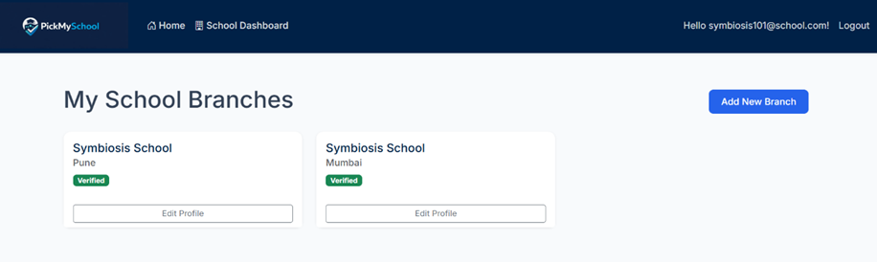
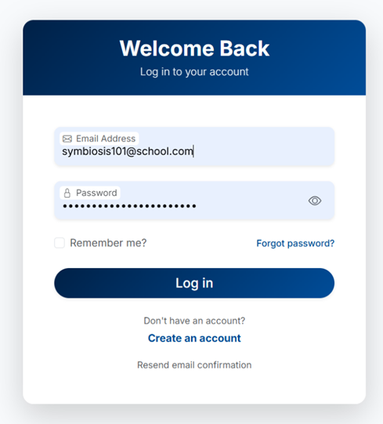
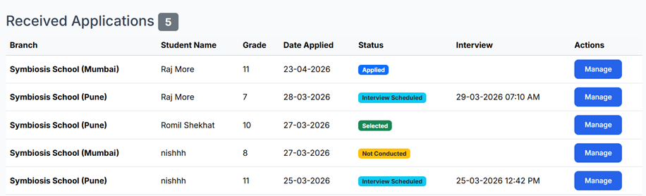

Slide 9
Limitations:
Depends on internet connectivity
Limited to registered schools
Basic security implementation
Incorrect data entered by users may affect admission processing
Requires regular database maintenance and updates
Future Enhancements:
AI-based school recommendation
Mobile application support
Online document verification
Payment gateway integration
SMS/Email notifications

Slide 10
Conclusion
Simplifies Admission Process : Provides a centralized platform that makes the admission process simple and organized.
Reduces Manual Work: Reduces paperwork and avoids repeated form filling for multiple schools.
Improves Transparency : Allows parents to track application status and improves communication with schools.
Saves Time :Speeds up the admission process and reduces unnecessary visits to schools.

Slide 11
Bibliography
Microsoft Documentation for ASP.NET
(https://learn.microsoft.com)
C# Programming Guide
ASP.NET Web Development Tutorials
(https://www.w3schools.com)
SQLite Official Documentation
(https://www.sqlite.org)
HTML, CSS, and JavaScript Tutorials
(https://developer.mozilla.org)

Slide 12
Thank
you

